Slide 1
Theory of Automata
Lecture # 13
Imtiaz Ahmed

Slide 2
Informal Definition of Mealy Machine
A Mealy machine consists of the following
A finite set of states q0, q1, q2, … where q0 is the initial state.
An alphabet of letters Σ = {a,b,c,…} from which the input strings are formed.
An alphabet Γ={x,y,z,…} of output characters from which output strings are generated.
A pictorial representation with states and directed edges labeled by an input letter along with an output character. The directed edges also show how to go from one state to another corresponding to every possible input letter.

Slide 3
Mealy Machine (Contd..)
Similar to Moore machine, in Mealy machine no state is designated to be a final state, so there is no question of accepting any language by Mealy machine.
However in some cases the relation between an input string and the corresponding output string may be identified by the Mealy machine.
Moreover the state to be initial is not important as if the machine is used several times and is restarted after some time, the machine will be started from the state where it was left off

Slide 4
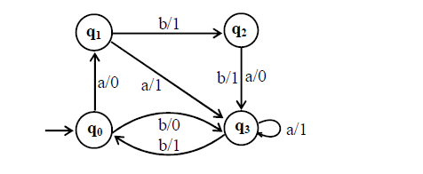
Mealy Machine (Example-1)
Consider the Mealy machine having the states q0, q1, q2, q3 , where q0 is the start state and Σ = {a,b}, Γ={0,1}
State Diagram

Slide 5
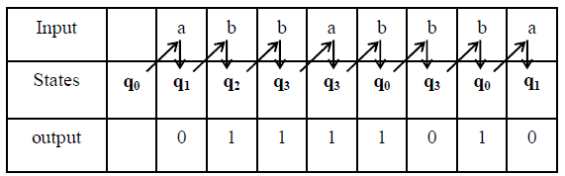
Mealy Machine (Example-1)
Running the string abbabbba over the given machine, the corresponding output string will be 01111010, which can be determined by the following table
In Mealy machine, the length of output string is equal to that of input string.

Slide 6
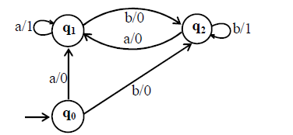
Mealey Machine (Example-2)
Consider the following Mealy machine having the states q0, q1, q2 , where q0 is the start state and Σ = {a,b}, Γ={0,1}
Find output string corresponding to the input string babaababba?

Slide 7
Class Assignment (Question 1)
Construct a Mealy Machine which complements a binary input
For example if input number 0010101 is passed to the Mealy Machine, it should convert above number to 1101010 which is 1’s complement of the given number

Slide 8
Class Assignment (Question 2)
Construct an incrementing Mealy Machine
If the right most bit of binary number, to be incremented, is 0, the output binary number can be obtained by converting the right most bit to 1 and remaining bits unchanged.
If the right most bit of binary number is 1 then the output can be obtained, converting that 1 along with all its concatenated 1’s to 0’s, then converting the next 0 to 1 and remaining bits unchanged.

Slide 9

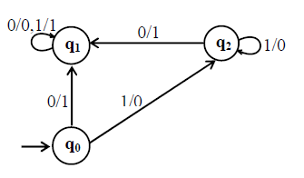
Solution of Class Assignment
Question 1:
Question 2:

Slide 10

Thanks!

